Slide 1
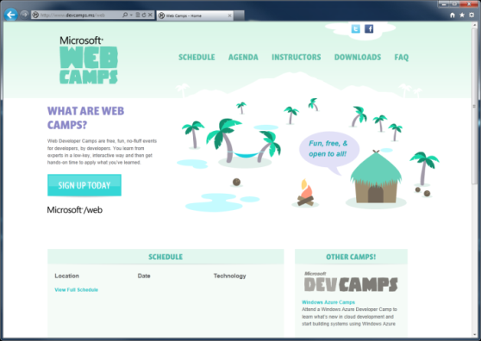

WebCamps Online
Twitter: Follow @webcamps Hashtag #devamps
SPEAKER NAME/HANDLE HERE
Website: http://www.devcamps.ms/web
What are web camps?
Web Developer Camps are free, fun, no-fluff events for developers, by developers. You learn from experts in a low-key, interactive way and then get hands-on time to apply what you’ve learned.

Slide 2
Building a Service Layer with ASP.NET Web API
Name
Title
Microsoft Corporation

Slide 3
Agenda
Why all the hype for Web APIs?
Building Web APIs for browser/JSON clients
Building Web APIs for native/non-browser clients

Slide 4


Today
Today if you want to reach your user, you have to reach their device
In this talk you’ll learn how

Slide 5
Comparison of WCF & ASP.NET Web API
WCF
Back-end Services
SOAP, WS-*
ASP.NET Web API
Front-end Services
Media Types: JSON, XML, form-URL-encoded, custom
Transports: HTTP, TCP, UDP, Queues, WebSockets, custom
Message patterns: request-reply, one-way, duplex
Use WCF Web HTTP to add HTTP endpoints to existing WCF services
Use WCF Data Services for full OData support
HTTP only
Request-reply only
REST, resource-centric
Use SignalR for asynchronous signaling (polling, long-polling, WebSockets)

Slide 6
Web API is a part of ASP.NET
HTML
XML
JSON
Web Forms
Razor View Engine
Code
Web Pages
MVC
MVC 4
Web API
ASP.NET Core
Modules
Handlers
Membership
Intrinsics
Caching
Etc.

Slide 7
Where Can You Get Web API?

Slide 8
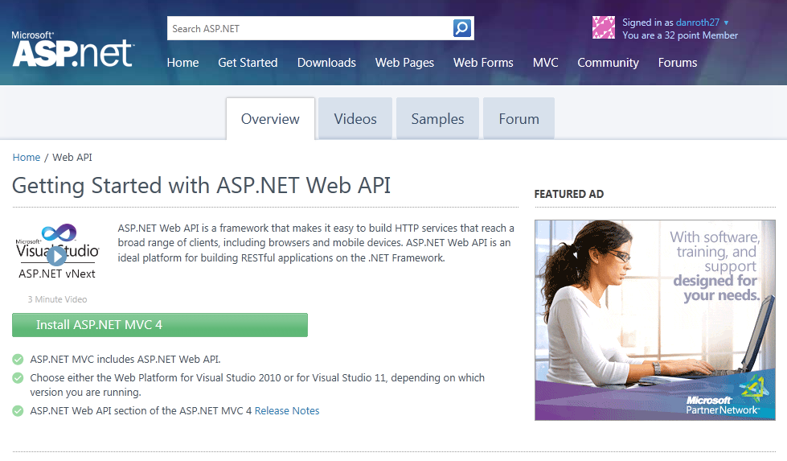
Homepage: asp.net/web-api

Slide 9
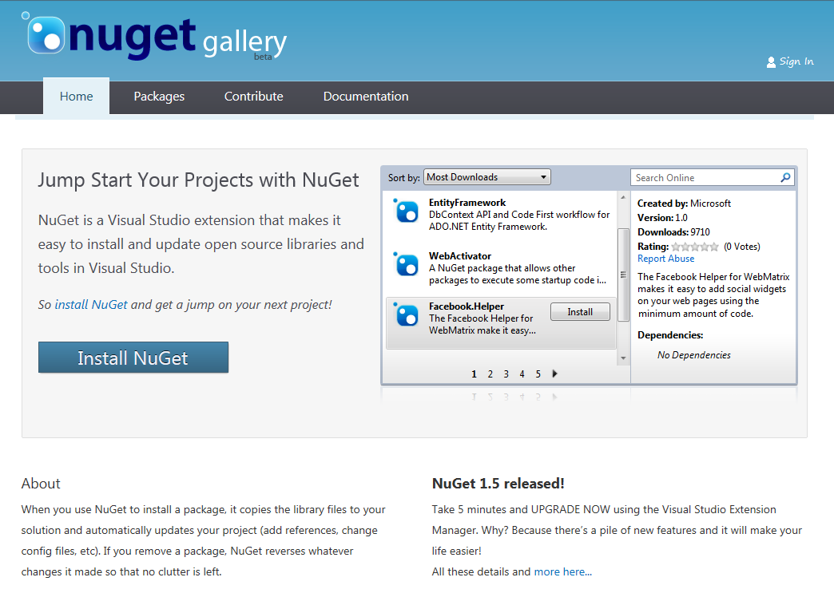
Find Us on Nuget
Nuget Packages
WebApi
WebApi.OData
JsonValue
HttpClient
WebApi.Enhancements

Slide 10
Building a Read Only Web API
Why?
Allow browser or other clients to easily retrieve information from your system

Slide 11
Sample Read-only Model and Controller
Step 1:
Create a Model
public class Person
{
public int Id { get; set; }
public string Name { get; set; }
}
Step 2:
Make an API Controller
public class PersonController : ApiController
{
List<Person> _people;
public PersonController()
{
_people = new List<Person>();
_people.AddRange(new Person[]
{
new Person { Id = 1, Name = "Chuck Norris" },
new Person { Id = 2, Name = "David Carradine" },
new Person { Id = 3, Name = "Bruce Lee" }
});
}
}

Slide 12
Read-only Controller Actions to return data
Step 3:
Return everything
// GET /api/person
public IEnumerable<Person> Get()
{
return _people;
}
Step 4:
Return one item
// GET /api/person/5
public Person Get(int id)
{
return _people.First(x => x.Id == id);
}

Slide 13
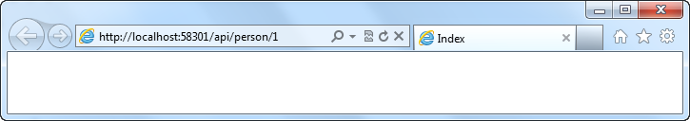
Routing a Web API Using Global.asax.cs
Routing:
Familiar syntax, conventional approach
public static void RegisterRoutes(RouteCollection routes)
{
routes.MapHttpRoute(
name: "DefaultApi",
routeTemplate: "api/{controller}/{id}",
defaults: new { id = RouteParameter.Optional }
);
}

Slide 14
Manipulating HTTP Responses
Return HttpResponseMessage<T> to modify response headers
Example
Find a person and return it, but what happens if we don’t find a match?
// GET /api/person/5
public HttpResponseMessage<Person> Get(int id)
{
try
{
var person = _people.First(x => x.Id == id);
return new HttpResponseMessage<Person>(
person,
HttpStatusCode.OK
);
}
catch
{
return new HttpResponseMessage<Person>(HttpStatusCode.NotFound);
}
}

Slide 15
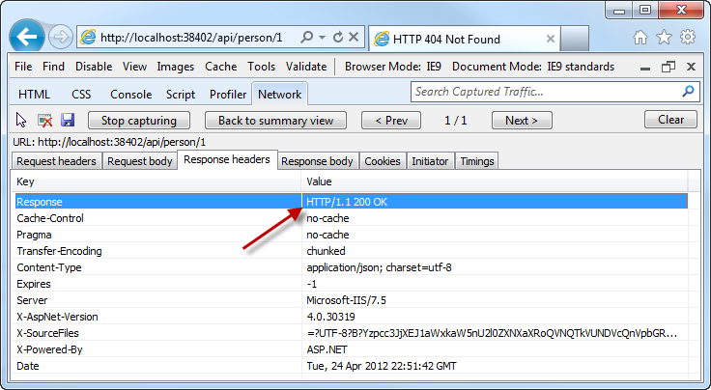
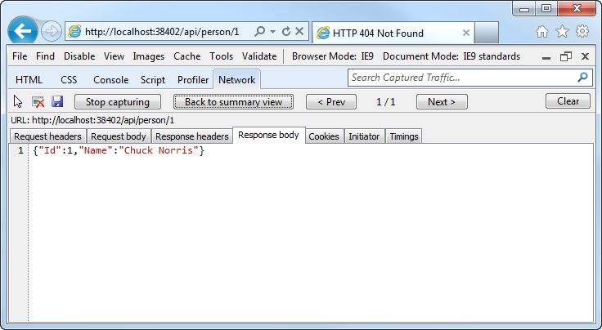
Manipulating HTTP Responses
A successful API call returns an HTTP OK and the JSON data

Slide 16
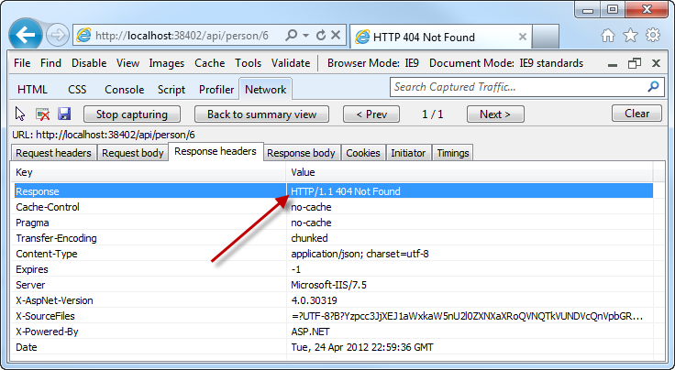
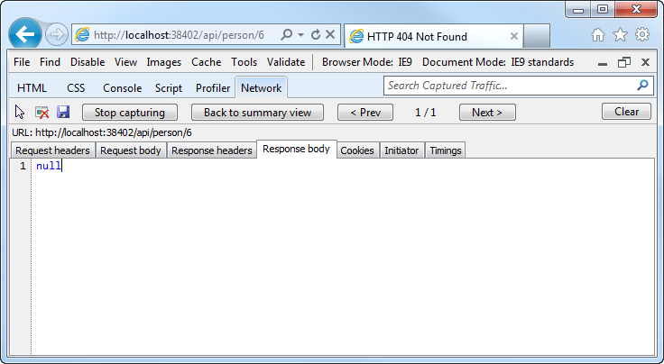
Manipulating HTTP Responses
An unsuccessful API call returns an HTTP 404 (and no JSON)

Slide 17
Building a read only Web API
demo

Slide 18
Making an API Updatable
Why?
Allow clients to modify the state of the server

Slide 19
Posting Data to a Web API
Use HTTP Post:
Pass a Model
public HttpResponseMessage Post(Person person)
{
person.Id = _people.Count + 1;
if (_people.Any(x => x.Id == person.Id))
return new HttpResponseMessage(HttpStatusCode.BadRequest);
try
{
_people.Add(person);
}
catch
{
return new HttpResponseMessage(HttpStatusCode.BadRequest);
}
return new HttpResponseMessage(HttpStatusCode.OK);
}

Slide 20
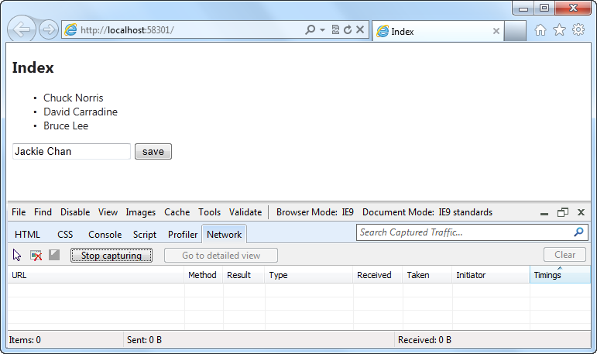
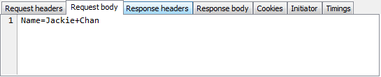
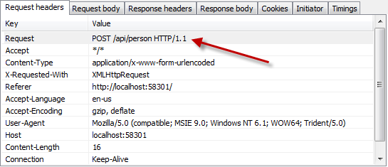
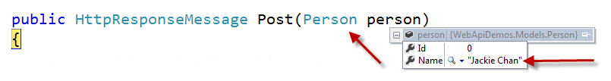
Posting Data to a Web API

Slide 21
Making an API updatable
demo

Slide 22
Supporting HTML File Upload
Why?
Allow clients to send files from a browser

Slide 23
Support HTML File Upload
IsMimeMultipartContent – checks if multipart
MultipartFormDataStreamProvider – parses the streams
BodyPartFileNames – returns the list of files sent in the stream

Slide 24
Uploading Files
Use HTTP Post:
Pass a Model
public async Task<IList<string>> Post()
{
List<string> result = new List<string>();
if (Request.Content.IsMimeMultipartContent())
{
MultipartFormDataStreamProvider stream =
new MultipartFormDataStreamProvider("c:/uploads/");
IEnumerable<HttpContent> bodyparts =
await Request.Content.ReadAsMultipartAsync(stream);
IDictionary<string, string> bodyPartFiles = stream.BodyPartFileNames;
bodyPartFiles
.Select(i => { return i.Key; })
.ToList()
.ForEach(x => result.Add(x));
}
return result;
}

Slide 25
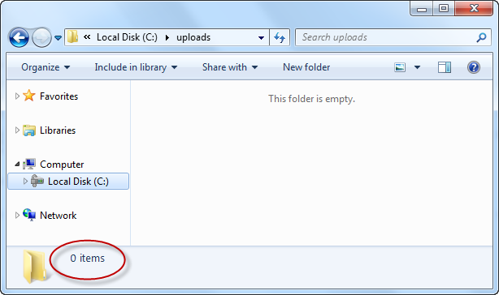
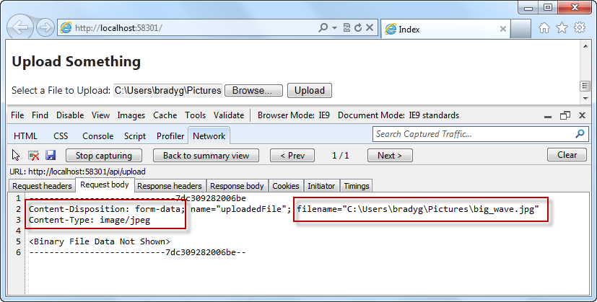
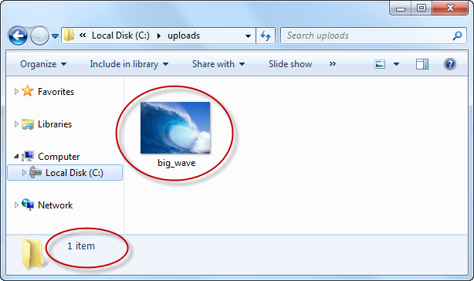
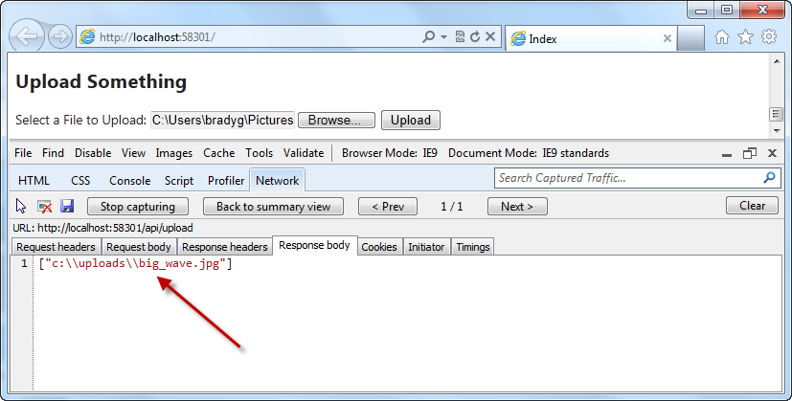
So what happens during upload?
Request – Note incoming filename
Response – Note saved filename

Slide 26
HTML file upload
demo
Using HttpContent to work with the body of the request

Slide 27
Web API is a part of ASP.NET
HTML
XML
JSON
Web Forms
Razor View Engine
Code
Web Pages
MVC
MVC 4
Web API
ASP.NET Core
Self Host
Modules
Handlers
Membership
Intrinsics
Caching
Etc.

Slide 28
Self Hosting Your Web API
Why?
More granular control
No need for a web server
Isolated cases requiring minimal resources via standard protocol sets
Why Not?

Slide 29
Configuring Your Web API for Self Host
HttpConfiguration provides a code based configuration mechanism
New it up directly or derive from it
Pass HttpConfiguration instance to HttpServiceHostFactory/HttpServiceHost

Slide 30
Self Hosting a Web API Controller is Easy
Console Host:
First set up the configuration and the routes, just like in Global.asax.cs.
Then, host the controller using HttpSelfHostServer and open the server up to listen for requests.
class Program
{
static void Main(string[] args)
{
// configure the server
var baseAddress = "http://localhost:8080/";
var config = new HttpSelfHostConfiguration(baseAddress);
config.Routes.MapHttpRoute(
name: "DefaultApi",
routeTemplate: "api/{controller}/{id}",
defaults: new { id = RouteParameter.Optional }
);
// Create and open the server
var server = new HttpSelfHostServer(config);
server.OpenAsync().Wait();
Console.WriteLine("The server is running...");
Console.ReadLine();
}
}

Slide 31
Self Hosting a Web API Controller is Easy
Controller:
This simple controller provides information about the server hosting the controller.
public class EnvironmentStatus
{
public string MachineName { get; set; }
public DateTime TimeOnServer { get; set; }
}
public class EnvironmentController : ApiController
{
public EnvironmentStatus Get()
{
Console.WriteLine(“User agent " + Request.Headers.UserAgent);
return new EnvironmentStatus
{
MachineName = Environment.MachineName,
TimeOnServer = DateTime.Now
};
}
}

Slide 32
Self Hosting Your Web API
demo

Slide 33
Configuring Media Type Formatters
Why?
Tweak our Xml/Json formatters
OData clients
Other native/non-browser clients
Custom media types

Slide 34
Configuring media type formatters
demo
ODATA, JSON.NET, HAL

Slide 35
What We Learned
Why Web APIs are important
How to author Web APIs for multiple clients
How configure a Web API
Enabling HTML file upload
Enabling OData and custom formats
Using the Web API test client

Slide 36
For More Information
http://www.asp.net/web-api
http://channel9.msdn.com/Shows/Web+Camps+TV/Dan-Roth-on-the-new-ASPNET-Web-API
http://blogs.msdn.com/b/henrikn/archive/2012/02/19/using-web-api-with-mongodb.aspx
Documentation & Articles

Slide 37
Resources
Feedback and questions http://forums.dev.windows.com
Session feedback http://bldw.in/SessionFeedback

